Slide 1
Case Studies in Data Citation
Day 2

Slide 2
Agenda
Why cite data?
Anatomy of a data citation
Implementing data citation initiatives
NCAR
IQSS @ Harvard
Tracking and tracing data citation

Slide 3
Why do we cite anything?
Paying homage
Giving credit
Identifying methodology
Background reading
Correcting own work
Correcting other’s work
Criticising previous work
Alerting re: forthcoming work
Providing leads
Authenticating data
Identifying the original paper
Arguing with others
Disputing the work of others
+more...
Garfield, E. (1996) When to cite. Library Quarterly, 66 (4): 449-458

Slide 4
Why do we cite data?
Paying homage
Giving credit
Identifying methodology
Background reading
Correcting own work
Correcting other’s work
Criticizing previous work
Alerting re: forthcoming work
Providing leads
Authenticating data
Identifying the original paper
Arguing with others
Disputing the work of others
+more...
Garfield, E. (1996) When to cite. Library Quarterly, 66 (4): 449-458

Slide 5
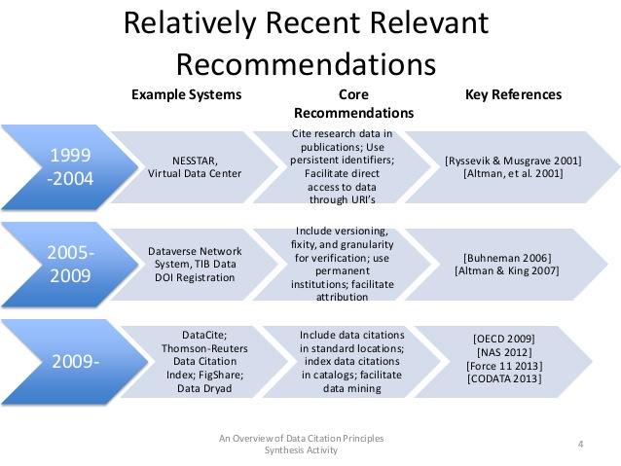
c/o Micah Altman http://www.slideshare.net/drmaltman/data-citationsynthesisteaser
Notes:
Relatively Recent Relevant Recommendations An Overview of Data Citation Principles Synthesis Activity 4 1999 -2004 NESSTAR, Virtual Data Center Cite research data in publications; Use persistent identifiers; Facilitate direct access to data through URI’s [Ryssevik & Musgrave 2001] [Altman, et al. 2001] 2005- 2009 Dataverse Network System, TIB Data DOI Registration Include versioning, fixity, and granularity for verification; use permanent institutions; facilitate attribution [Buhneman 2006] [Altman & King 2007] 2009- DataCite; Thomson-Reuters Data Citation Index; FigShare; Data Dryad Include data citations in standard locations; index data citations in catalogs; facilitate data mining [OECD 2009] [NAS 2012] [Force 11 2013] [CODATA 2013] Example Systems Core Recommendations Key References

Slide 6

Data Citation Principles

Slide 7
Working group goals:
Purpose, function and attributes of citations.
Find balance between human understandable and machine-actionable.
Not comprehensive recommendations for data stewardship.
Encourage communities to develop practices and tools that embody these principles.

Slide 8
Importance
Data should be considered legitimate, citable products of research. Data citations should be accorded the same importance in the scholarly record as citations of other research objects, such as publications.

Slide 9
Credit and Attribution
Data citations should facilitate giving scholarly credit and normative and legal attribution to all contributors to the data, recognizing that a single style or mechanism of attribution may not be applicable to all data

Slide 10

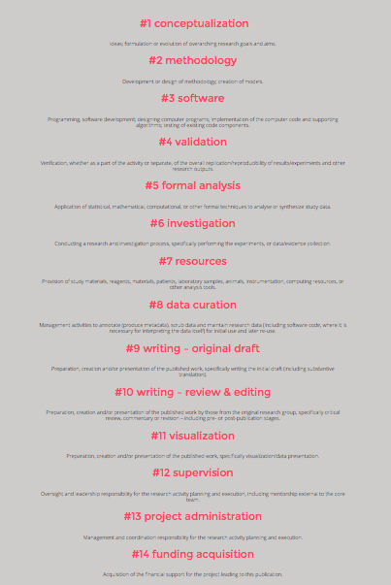

Slide 11
Evidence
In scholarly literature, whenever and wherever a claim relies upon data, the corresponding data should be cited.

Slide 12
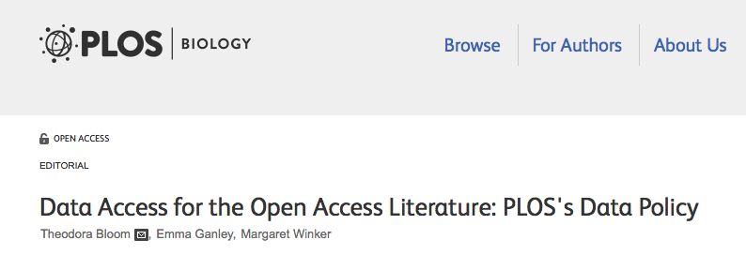
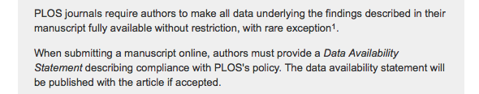
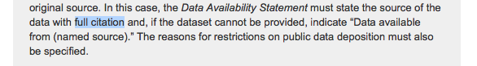
Notes:
Example from a recent policy change at the worlds third largest publisher …

Slide 13
Unique Identification
A data citation should include a persistent method for identification that is machine actionable, globally unique, and widely used by a community[4].

Slide 14
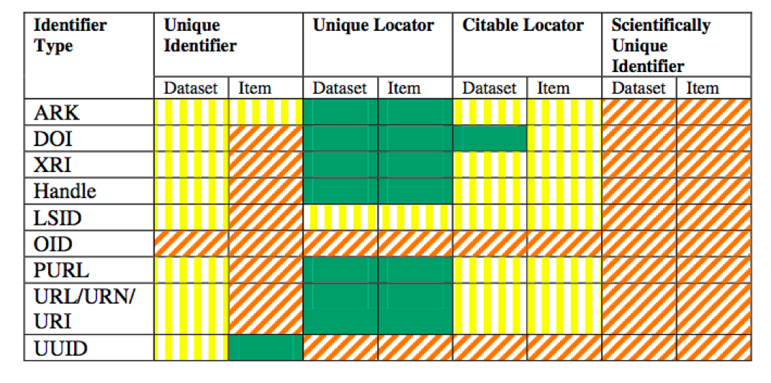
Notes:
The point is not that any one of these are right or wrong –but that they work for certain communities, and not for others… as we will see in our two case studies…

Slide 15
Access
Data citations should facilitate access to the data themselves and to such associated metadata, documentation, code, and other materials, as are necessary for both humans and machines to make informed use of the referenced data.

Slide 16
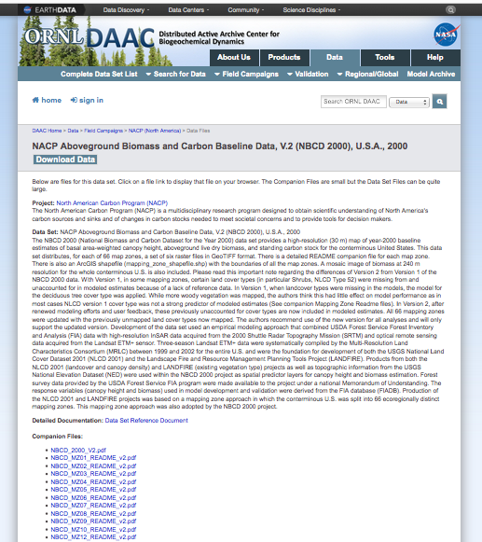
Where should the identifier resolve?
http://dx.doi.org/10.3334/
ORNLDAAC/1081

Slide 17
Persistence
Unique identifiers, and metadata describing the data, and its disposition, should persist -- even beyond the lifespan of the data they describe

Slide 18
Specificity and Verifiability
Data citations should facilitate identification of, access to, and verification of the specific data that support a claim. Citations or citation metadata should include information about provenance and fixity sufficient to facilitate verfiying that the specific timeslice, version and/or granular portion of data retrieved subsequently is the same as was originally cited

Slide 19
Interoperability and Flexibility
Data citation methods should be sufficiently flexible to accommodate the variant practices among communities, but should not differ so much that they compromise interoperability of data citation practices across communities

Slide 20
Brainstorm …
How are citations to data different than citations to bibliographic resources?
What are some problems in citing that should be remedied, and how might we solve them?

Slide 21
Problems in citing data
Authorship
Dynamic / Versioned resources (which data?)
Granularity – no chapter, page, or paragraph markings

Slide 22
Anatomy of a Data Citation
Could include any of the the following elements:
Author, publication date, publisher, resource type (database, dataset, image, etc.), location, identifier, version, edition, title, etc.
Ball, A. & Duke, M. (2012). ‘How to Cite Datasets and Link to Publications’. DCC How-to Guides. Edinburgh: Digital Curation Centre. Available online: http://www.dcc.ac.uk/resources/how-guides - See more at: http://www.dcc.ac.uk/resources/how-guides/cite-datasets#sthash.EY03YKRD.dpuf

Slide 23
Anatomy of a Data Citation:
Earth Science Informatics Partners (ESIP) recommendation:
Zwally, H.J., R. Schutz, C. Bentley, J. Bufton, T. Herring, J. Minster, J. Spinhirne, and R. Thomas. 2003. GLAS/ICESat L1A Global Altimetry Data V018, 15 October to 18 November 2003. National Snow and Ice Data Center. dataset accessed 2011-07-21 at doi:10.3334/NSIDC/gla01.

Slide 24
Anatomy of a Data Citation:

Slide 25
Anatomy of a Data Citation
APA Cool, H. E. M., & Bell, M. (2011). Excavations at St Peter’s Church, Barton-upon-Humber [Data set]. doi:10.5284/1000389
Chicago (notes) 2. H. E. M. Cool and Mark Bell, Excavations at St Peter’s Church, Barton-upon-Humber (accessed May 1, 2011), doi:10.5284/1000389.
Cool, H. E. M., and Mark Bell. Excavations at St Peter’s Church, Barton-upon-Humber (accessed May 1, 2011). doi:10.5284/1000389.
MLA Cool, H. E. M., and Mark Bell. “Excavations at St Peter’s Church, Barton-upon-Humber.” Archaeology Data Service, 2001. Web. 1 May 2011. <http://dx.doi.org/10.5284/1000389>.
Oxford Cool, H. E. M. & Bell, M. (2011) Excavations at St Peter’s Church, Barton-upon-Humber [data-set]. York: Archaeology Data Service [distributor] <DOI 10.5284/1000389>.
See more at: http://www.dcc.ac.uk/resources/how-guides/cite-datasets#x1-13000
Notes:
Humanities and Social Science standards.

Slide 26
Data Citation Infrastructure
Step 1: Archived data
Step 2: Landing Page
Step 3: Persistent Identifier
Step 4: Clear metadata
Step 5: Advertisement (cite our data like this…)
Notes:
Can be achieved in many ways…

Slide 27
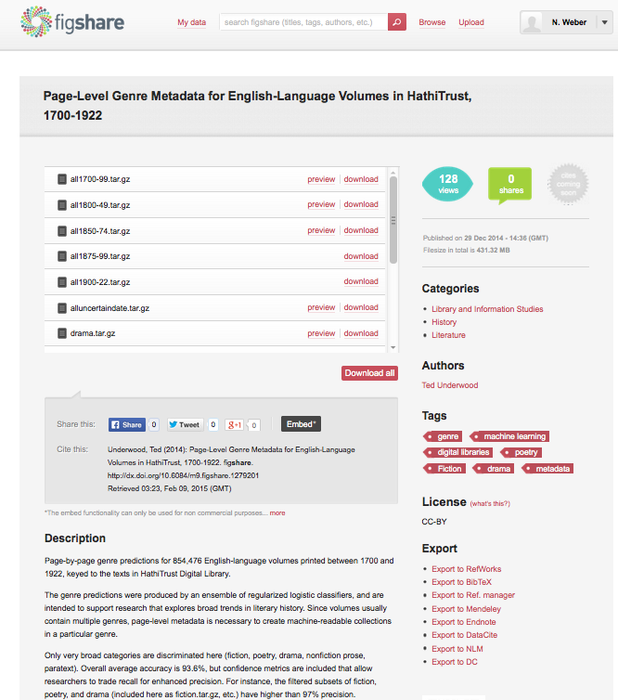
Step 1 (data archived on FigShare)
Step 2 (Creates landing Page)
Step 3: Persistent Identifier (DOI)
Step 4: Clear metadata (?)
Step 5: Advertise (!)
Notes:
DIY aporoach

Slide 28
Data Citation Infrastructure
Step 1: Archived data
Step 2: Landing Page
Step 3: Persistent Identifier
Step 4: Clear metadata
Step 5: Advertisement (cite our data like this…)
Notes:
Can be achieved in many ways…

Slide 29
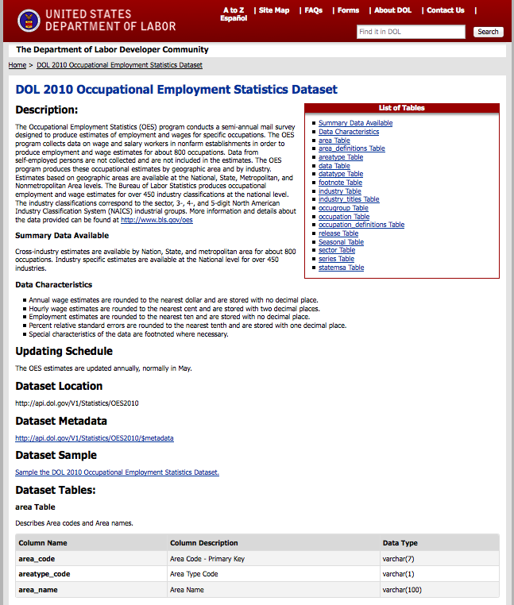
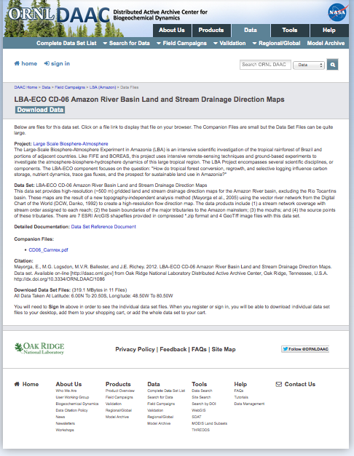
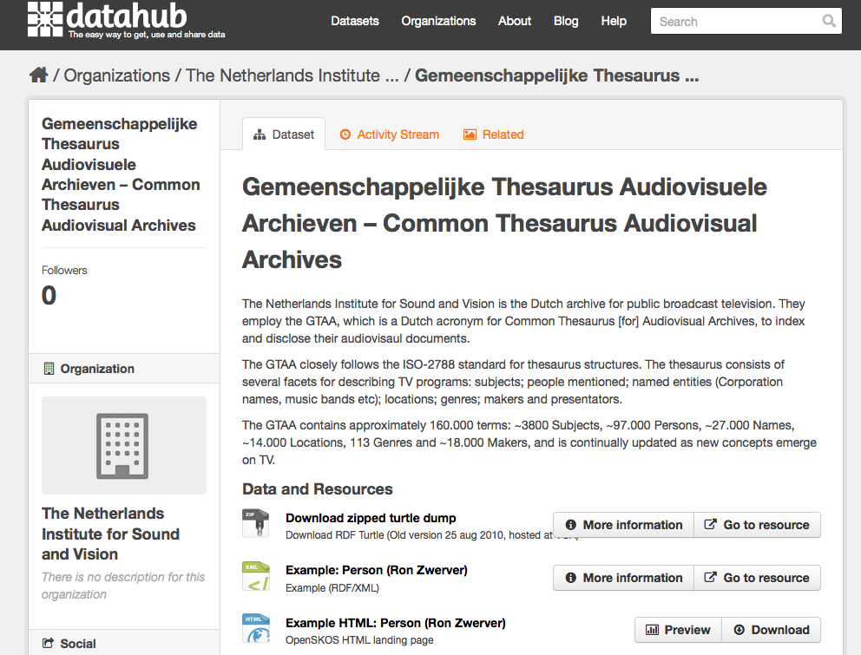
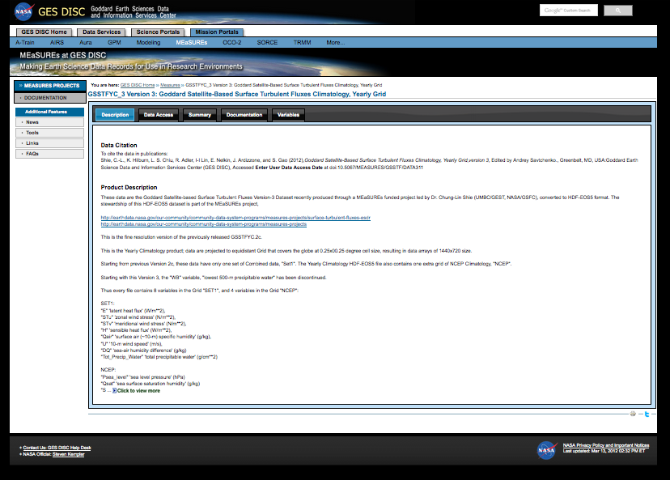

Slide 30
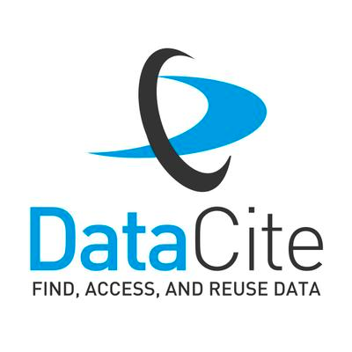
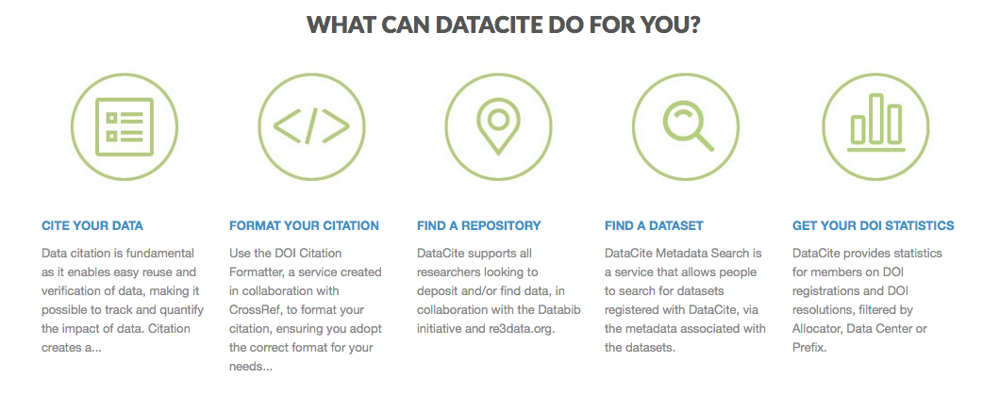
Notes:
Setting up data services… Roll your own…

Slide 31
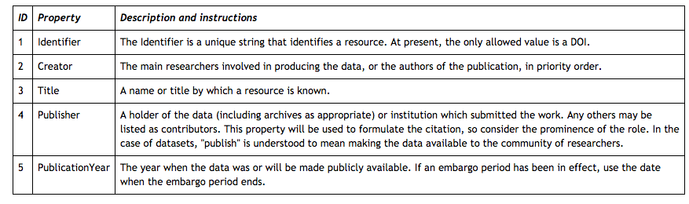

Slide 32
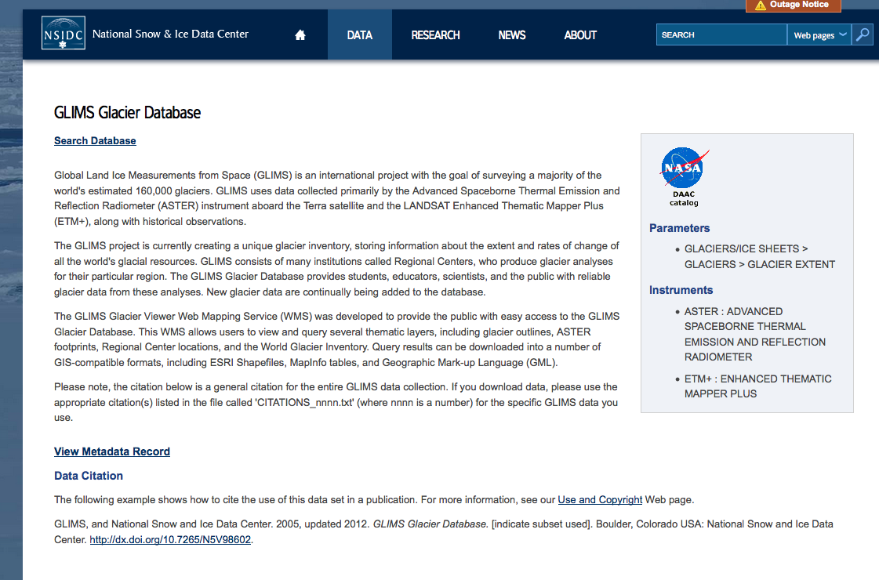

Slide 33
Some Open Issues

Slide 34
Data Citation in the Humanities?
What kind of data?
• digitized editions of major works;
• transcriptions of manuscripts;
• thematic collections (e.g., author, period, genre);
• language corpora (balanced or opportunistic; monolingual or multilingual [parallel structure or parallel-text translation equivalents]);
• images of artworks (e.g., Rossetti, Blake, DeYoung Museum ImageBase); and
• maps.
http://www.nap.edu/openbook.php?record_id=13564&page=59

Slide 35
Major issues in DH citation…
“When a data resource is tightly coupled with a particular piece of software, it can be difficult to distinguish the one from the other, with consequent difficulties for anyone who would like to cite the data resource itself, and not the data-plus-software combination.”
Michael Sperberg-McQueen

Slide 36
More issues… (also from MSM)
Copyright - “we ran a stylometric analysis on a corpus which has these properties, but we cannot let you see the actual corpus because we did not obtain the copyright.”
Anti-scientism – DH data are different, and not subject to same conventions (naive interp.)
Quiddity - Large humanities projects typically make multiple passes over material. reading text; text-critical variorum text; text with literary annotations; linguistic annotations (glosses for cruxes? parse trees? …); or formalization of propositional content.

Slide 37
Significant Identities
ORCID ID – people
Accession numbers – data
PIs – resource landing page
Versions
Institutions
Titles

Slide 38
Dynamic Data Citation
“…query centric approach”
utilize query languages to construct arbitrary subsets
data is maintained with version over time
the queries can be use to access the same data set again
Proll, S., & Rauber, A. (2013, October). Scalable data citation in dynamic, large databases: Model and reference implementation. In Big Data, 2013 IEEE International Conference on (pp. 307-312). IEEE.
Notes:
Very much an open issue…

Slide 39

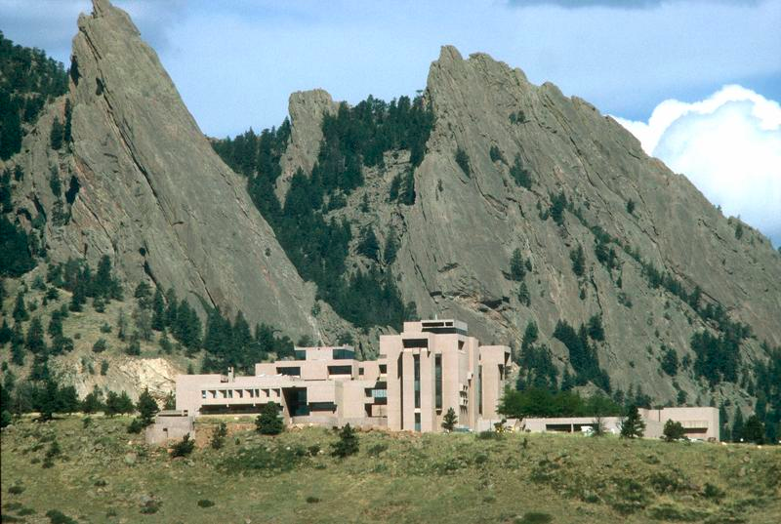
Case Study 1

Slide 40
Most of these slides were provided by Matt Mayernik – Research Scientists at NCAR See: https://library.ucar.edu/sites/default/files/content_files/Mayernik_pres_DCERC_June2012_final.pdf

Slide 41
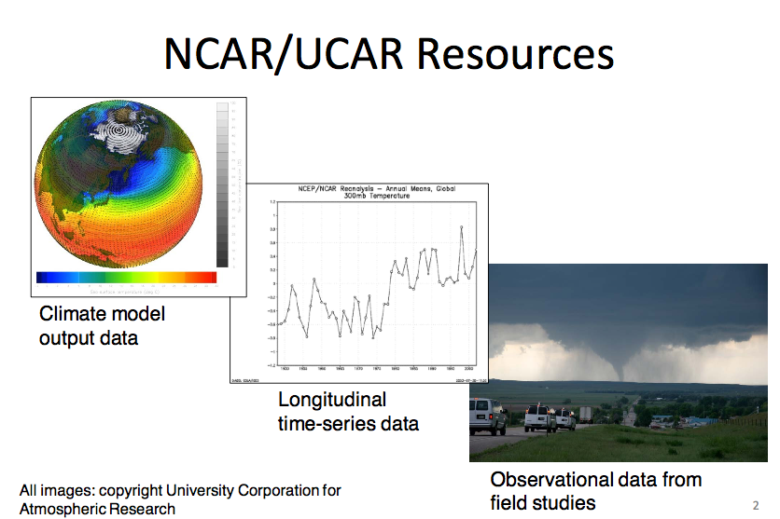

Slide 42
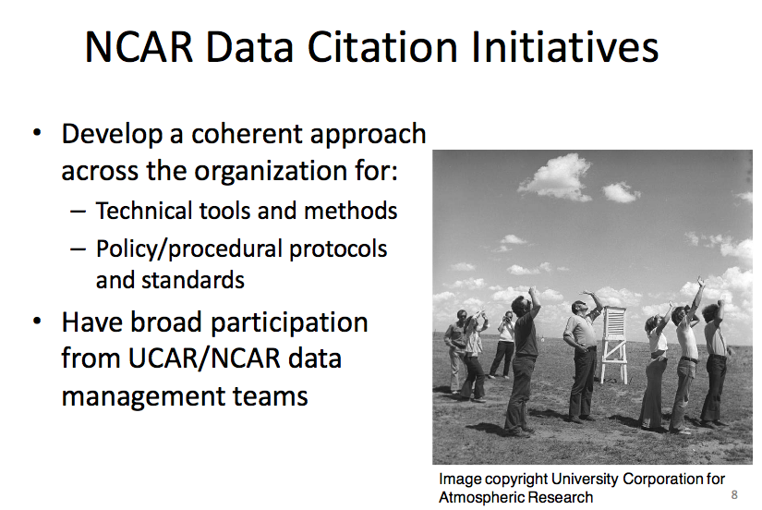

Slide 43
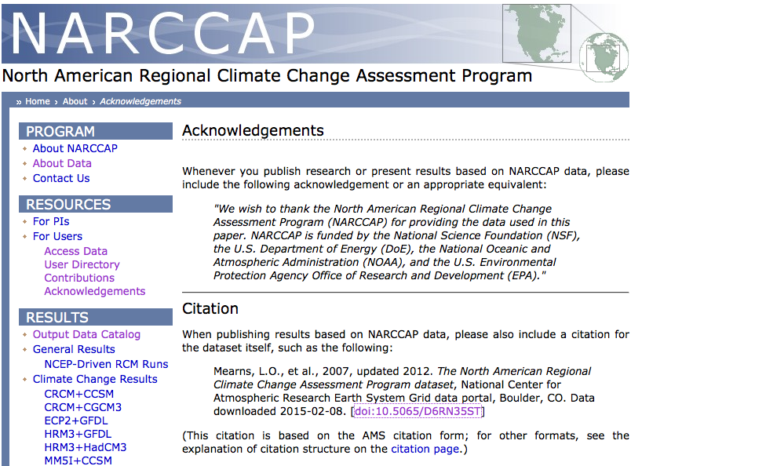

Slide 44
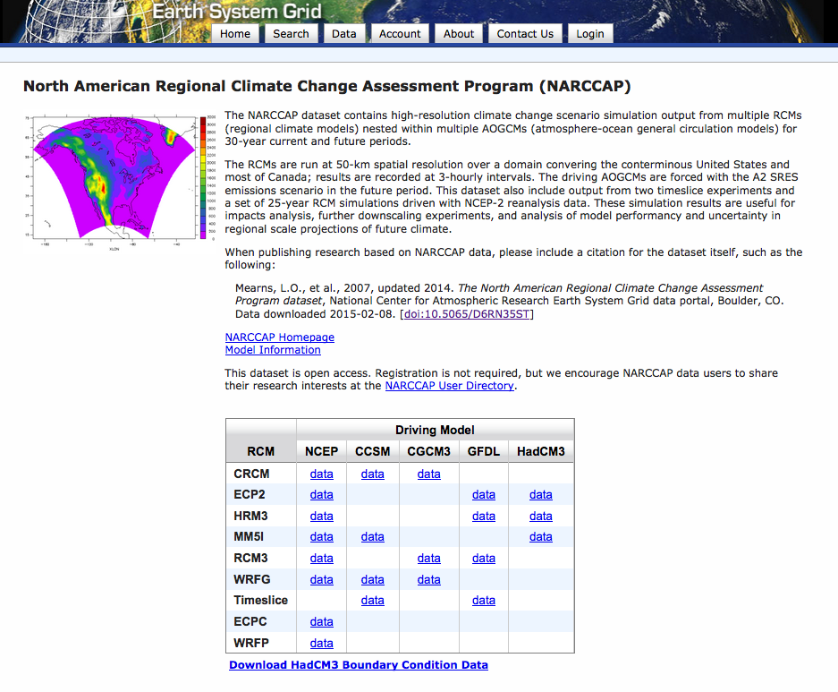
Notes:
Landing page..

Slide 45
Data archives
– Who should be assigning identifiers
– How to assign identifiers to resources
– How to register identifier metadata
– How to ensure that identifiers will be maintained
– How to provide recommended citations to users
Outreach to users
–Make citation information easy to find/use
–Proactively inform users about citations and identifiers

Slide 46
NCAR – Use of DOIs
…use completely randomly generated DOIs for the reasons that
any organizational-specific components would become out of date if data are moved between archives or organizations and
2) any intelligence built into a DOI is another thing that needs to be managed and maintained over the long term.
Down side: human-readability, consolidation with internal ID schemes, and easier Google searching for groups of IDs.

Slide 47

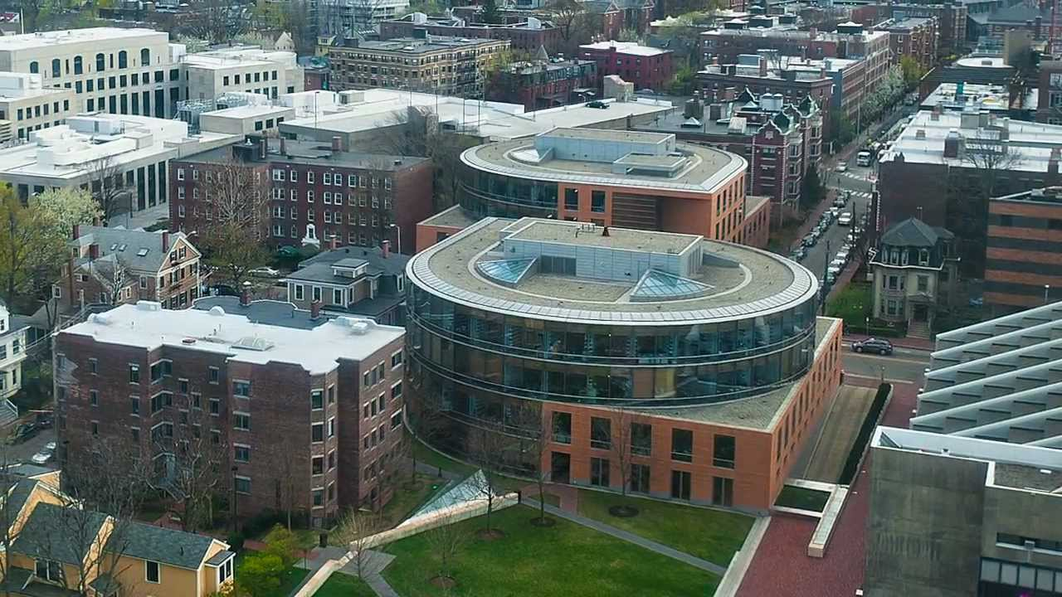
Case Study 2

Slide 48
Social science data and the UNF
http://thedata.org/citation
IQSS + Dataverse

Slide 49
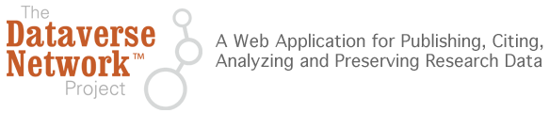
…develops software, protocols, and community connections for creating research data repositories that automate professional archival practices, guarantee long term preservation, and enable researchers to share, retain control of, and receive web visibility and formal academic citations for their data contributions.

Slide 50
Example Citations…
From International Studies Quarterly, King and Zeng, 2007, p. 209:
- Gary King; Langche Zeng, 2006, "Replication Data Set for 'When Can History be Our Guide? The Pitfalls of Counterfactual Inference'" hdl:1902.1/DXRXCFAWPK UNF:3:DaYlT6QSX9r0D50ye+tXpA== Murray Research Archive [distributor]
From Political Analysis, Hanmer, Banks, and White, 2013:
- Hanmer, Michael J.; Banks, Antoine J., White, Ismail K., 2013, "Replication data for: Experiments to Reduce the Over-reporting of Voting: A Pipeline to the Truth", http://dx.doi.org/10.7910/DVN/22893 UNF:5:eJOVAjDU0E0jzSQ2bRCg9g== IQSS Dataverse Network [Distributor]
Notes:
Examples of data cited in dataverse holdings…

Slide 51
Depends upon a UNF…
http://thedata.org/book/universal-numerical-fingerprint

Slide 52
Part of replication initatives
Copy over the replication criteria from IQSS:
http://thedata.org/book/replication-guidelines

Slide 53
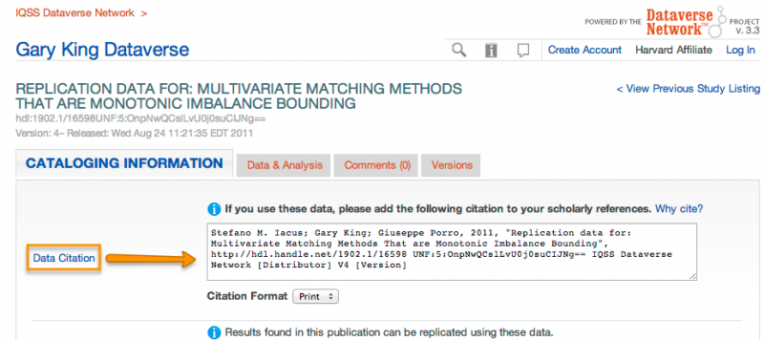
DataVerse: Citation Baked-In

Slide 54
Tracking and tracing data citations…

Slide 55
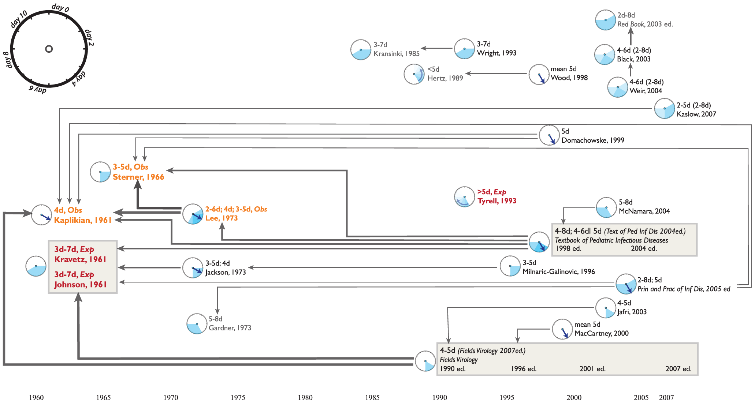
... tracking and tracing data…sometimes the facts don’t add up
Reich NG, Perl TM, Cummings DAT, Lessler J (2011) Visualizing Clinical Evidence: Citation Networks for the Incubation Periods of Respiratory Viral Infections. PLoS ONE 6(4): e19496. doi:10.1371/journal.pone.0019496

